Slide 1
Car Price Estimation Analysis
Nick Blackford

Slide 2
Overview of Variables
The dataset contains the following variables:
- year: The year in which the car was manufactured
- km_driven: The total kilometers driven by the car
- selling_price: The price at which the car is being sold
- fuel: The type of fuel used by the car (e.g., Diesel, Petrol)
- transmission: The type of transmission in the car (e.g., Manual, Automatic)

Slide 3
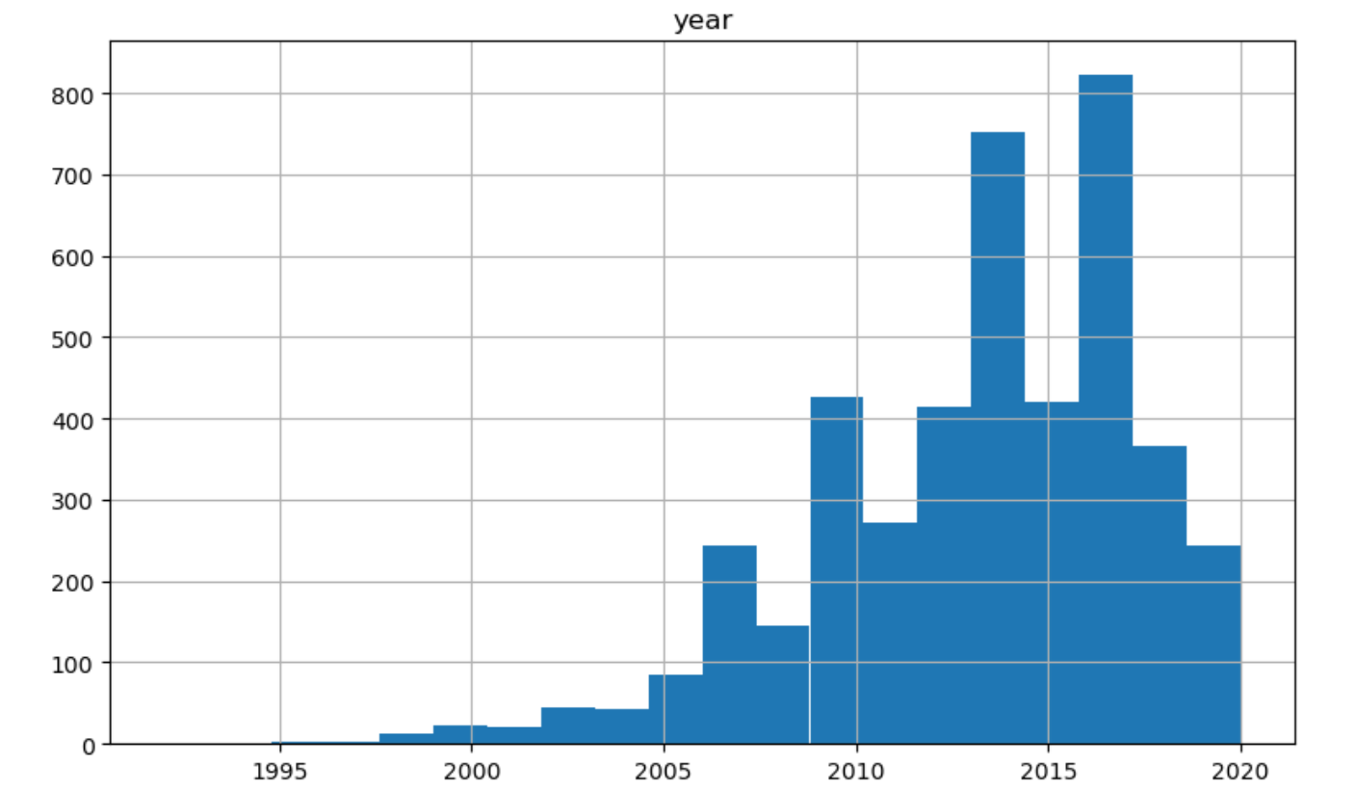
Histogram of year

Slide 4
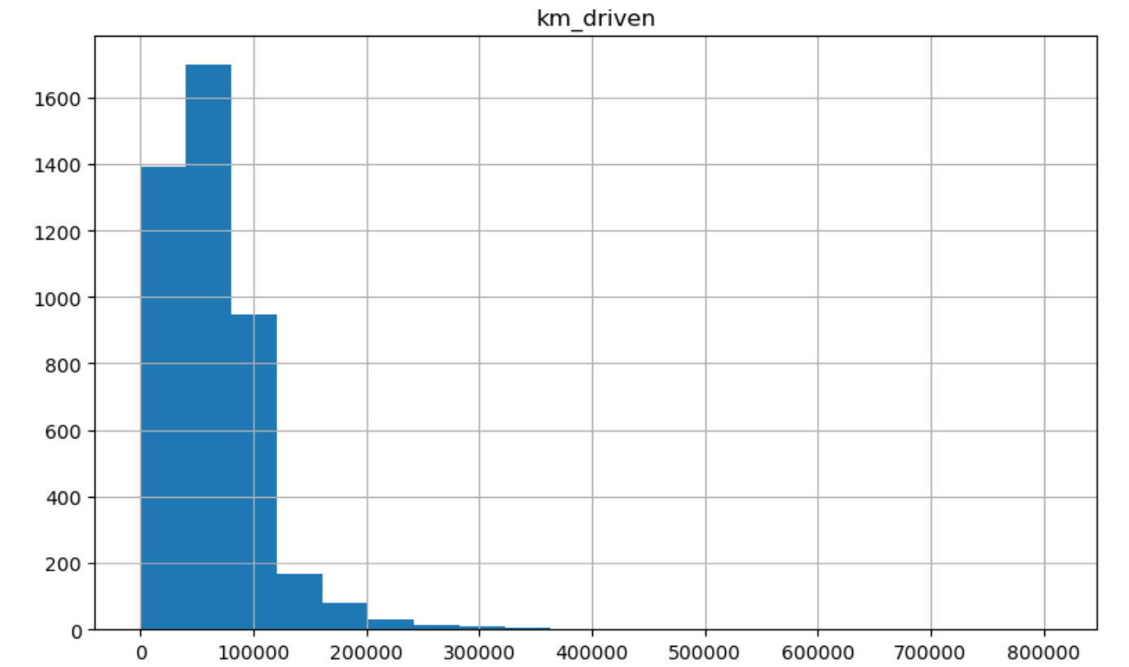
Histogram of km_driven

Slide 5
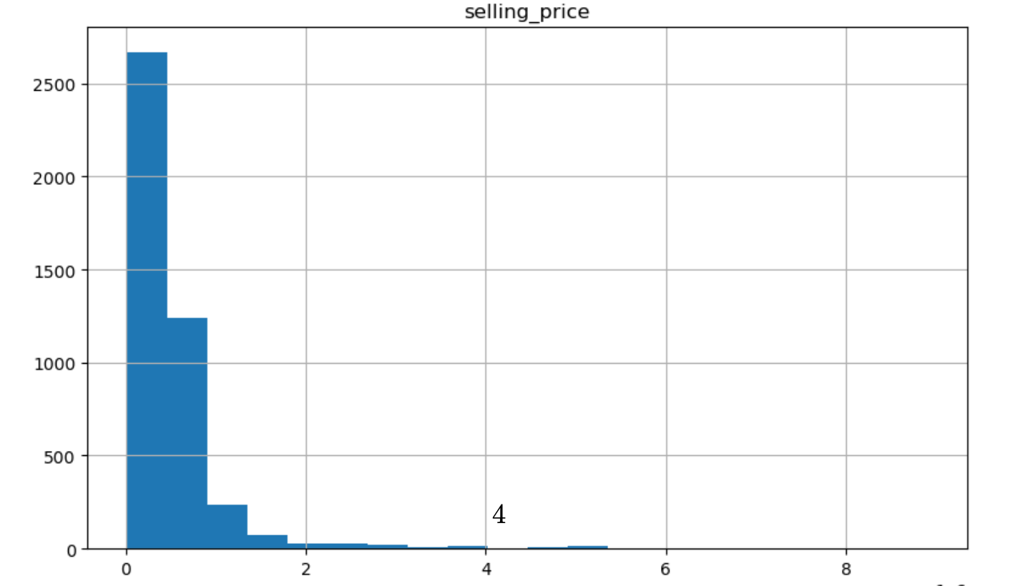
Histogram of selling_price

Slide 6
Outliers
There were no outliers in this dataset. If there were, we would handle them by removing or transforming them depending on the context.
For an expensive car we would likely keep the outlier
For a car with a selling price below $500, we would likely exclude as this price is unrealistic to be fair market value for the car

Slide 7
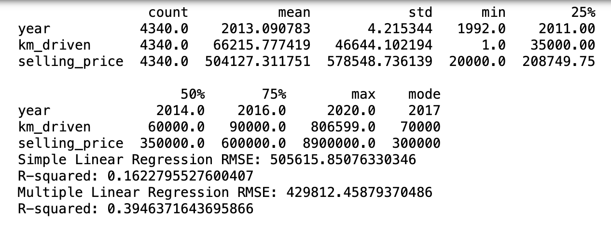
Descriptive Statistics

Slide 8
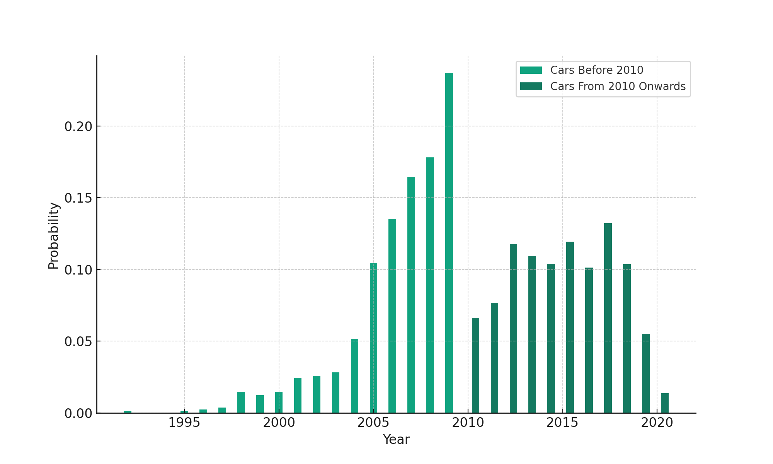
PMF Comparison: Cars Before and From 2010

Slide 9
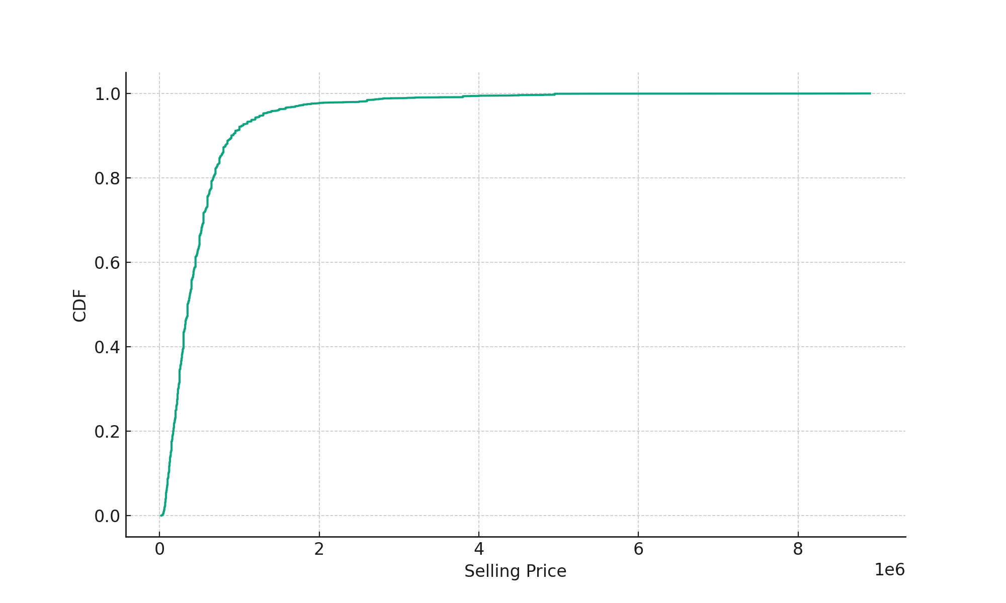
CDF of Selling Price

Slide 10
CDF Analysis
Insight from CDF: The Cumulative Distribution Function (CDF) plot shows the proportion of cars sold at or below a given price. For example, if the CDF value is 0.5 at a selling price of $10,000, it means that 50% of the cars are sold for $10,000 or less.
The CDF plot helps us understand what the distribution of selling prices looks like.

Slide 11
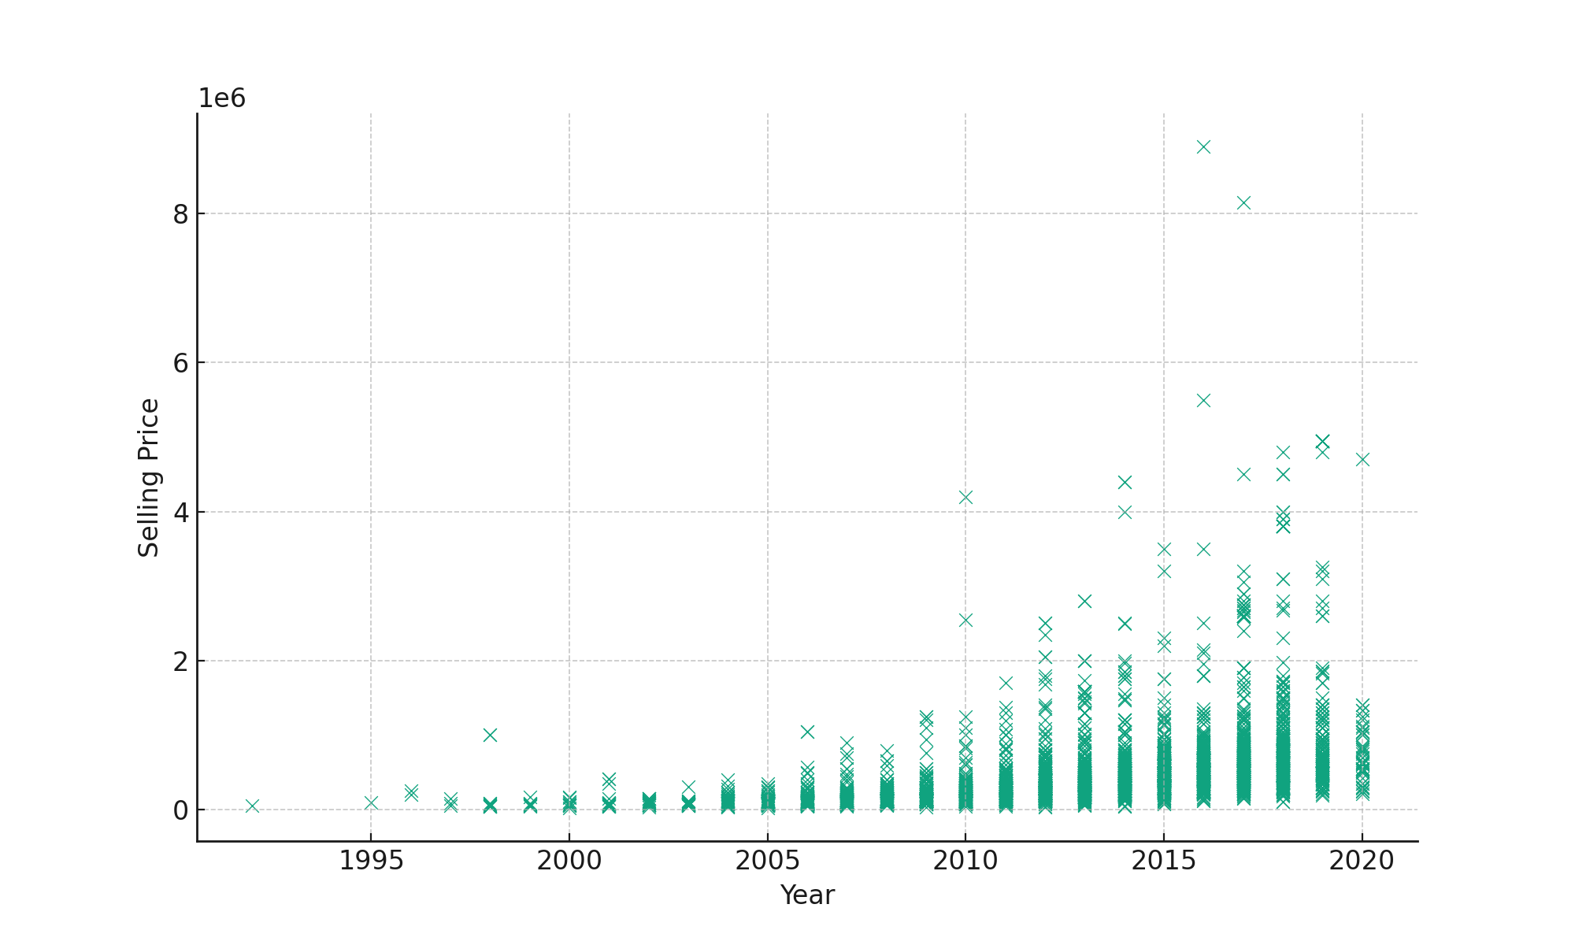
Scatter Plot: selling_price vs year

Slide 12
Scatter Plot: selling_price vs year
There is a positive correlation between the year of manufacture and the selling price, indicating that newer cars tend to be sold for higher prices.
The relationship appears to be linear, suggesting that the increase in price with each passing year is consistent.
Pearson's correlation coefficient can be calculated to quantify the strength of this linear relationship.

Slide 13
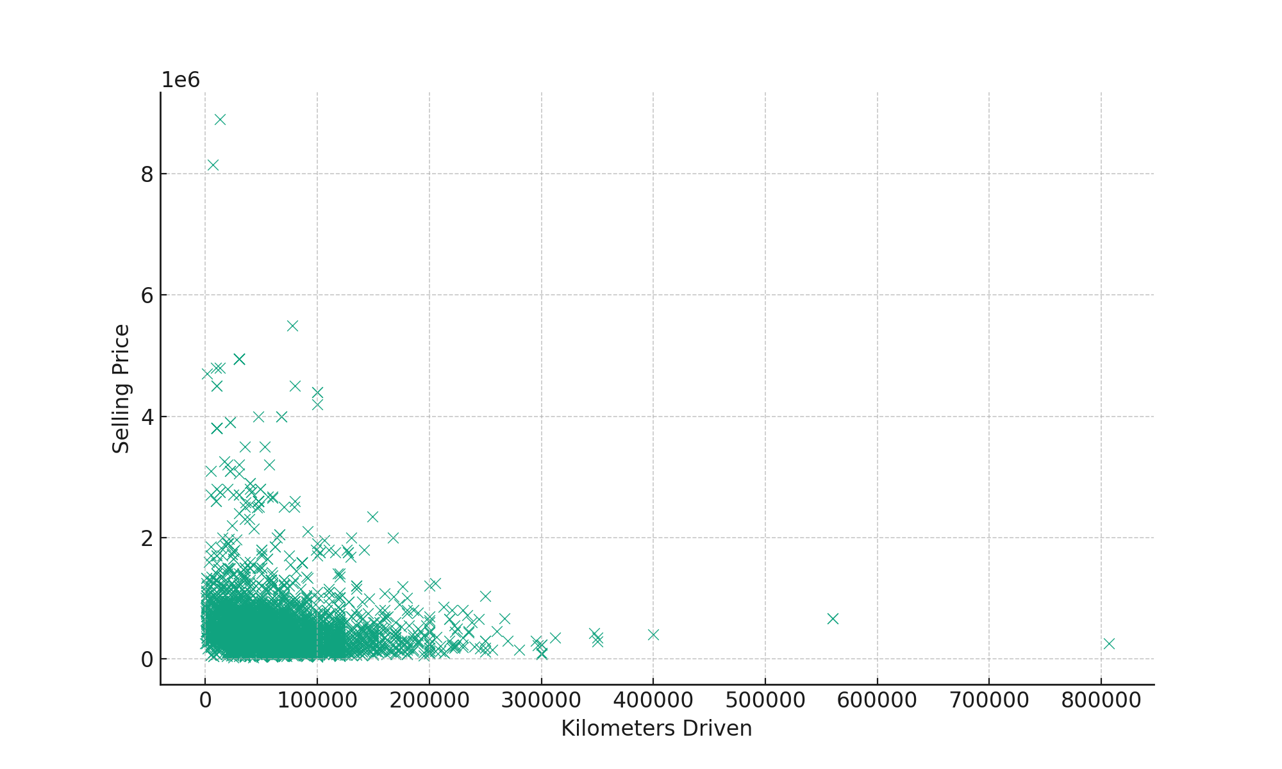
Scatter Plot: selling_price vs km_driven

Slide 14
Scatter Plot: selling_price vs km_driven
There is a negative correlation between the kilometers driven and the selling price, indicating that cars with higher mileage tend to be sold for lower prices.
The relationship might not be strictly linear, and further analysis could be done to explore any non-linear patterns.
Covariance can be calculated to understand the direction of the relationship, while Pearson's correlation coefficient can quantify the strength of the linear relationship.

Slide 15
Simple Linear Regression
Selling price = year + b
Simple Linear Regression RMSE: 505615.8507633035
R-squared: 0.16227955276004047

Slide 16
Multiple Linear Regression
Selling price = year + km_driven + fuel_Diesel + transmission_Manual
Multiple Linear Regression RMSE: 429812.45879370533
R-squared: 0.3946371643695855

Slide 17
Conclusion
The analysis provided insights into the factors affecting car selling prices.
Simple and multiple linear regression models were used to estimate selling prices based on various predictors.
The results indicate that the year of manufacture and kilometers driven are significant predictors of selling price.

